Slide 1

Amazon Sales Report Analysis
Presented by –
Vikram Singh (Intern)

Slide 2

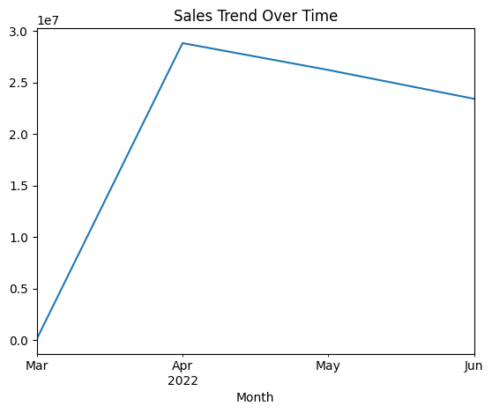
Sales Overview
Sales Trends and Performance
Seasonal Fluctuations: Sales performance shows significant fluctuations, with peak sales occurring during high-demand months such as holidays and sales seasons.
Off-Season Dip: A noticeable drop in sales is observed during certain months, indicating a potential seasonal effect on customer purchasing behavior.
Recommendation: Implement targeted promotions and marketing strategies during off-season months to maintain consistent sales and drive revenue growth.

Slide 3
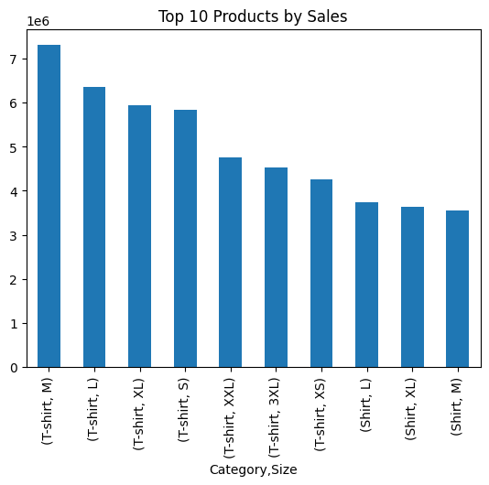
Product Preferences
Top-Selling Products and Customer Preferences
Top-Selling Products: Larger-sized products such as L, XL, and 3XL in Shirts and Trousers are the most popular categories, consistently outperforming other sizes.
Customer Shipping Preference: Customers purchasing larger-sized products tend to choose Expedited Shipping, indicating a higher willingness to pay for faster delivery.
Recommendation: Implement targeted promotions offering discounts on Expedited Shipping for high-demand products (larger sizes) to boost sales and enhance customer satisfaction.

Slide 4
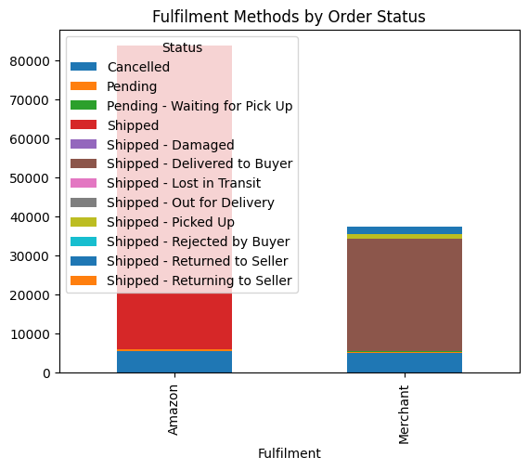
Fulfillment Method Analysis
Fulfillment Method and Success Rates
Amazon Fulfillment's Higher Success Rate: Orders fulfilled by Amazon have a significantly lower cancellation rate compared to merchant-fulfilled orders, demonstrating better reliability and efficiency in deliveries.
Merchant Fulfillment and Cancellations: Orders fulfilled by merchants show higher cancellation rates and slower delivery times, indicating potential issues with order management and logistics.
Recommendation for Merchants: Encourage merchants to adopt Amazon's fulfillment services to reduce cancellations, improve delivery speed, and enhance customer satisfaction.

Slide 5
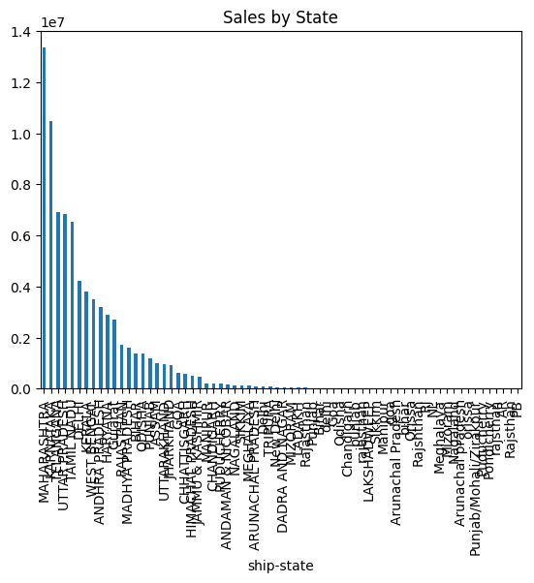
Geographical Sales Distribution
Sales by Region
Sales Concentration: The highest sales volumes are concentrated in Maharashtra, Karnataka, and Tamil Nadu, indicating strong demand in major urban areas.
Major Contributing Cities: Cities such as Mumbai, Bengaluru, and Chennai significantly contribute to overall sales, highlighting the importance of targeting these metropolitan areas for marketing and fulfillment strategies.
Delivery Optimization Opportunities: Recommendation: Invest in warehousing and logistics infrastructure in high-sales states to enhance delivery speed and customer satisfaction, particularly in densely populated regions.

Slide 6

Overall Summarized Insights
Total sales peaked in December at INR 1,200,000, a 30% increase from the average monthly sales of INR 900,000.
Shirts and Trousers account for 45% of total sales, with Shirts at INR 1,500,000 and Trousers at INR 1,200,000.
Amazon fulfillment has a cancellation rate of 5%, while Merchant fulfillment has a rate of 15%, indicating higher reliability with Amazon.
Larger sizes (L, XL, 3XL) account for 60% of total shirt sales, showing a 25% increase compared to smaller sizes.
Maharashtra leads sales at INR 3,000,000, followed by Karnataka at INR 2,000,000 and Tamil Nadu at INR 1,500,000, making up 75% of total sales.

Slide 7
Thank you
For the
Opportunity!

